Slide 1
Genotype Ontology Description for VMC Document
"The GENO Ontology builds on the SO to include richer modeling of genetic variation at different levels of granularity that are captured in genotype representations. Unlike the SO which is used primarily for annotation of genomic features, GENO was developed by the Monarch Initiative to support semantic data models for integrated representation of genotypes and genetic variants described in human and model organism databases. The core of the GENO model decomposes a genotype specifying sequence variation across an entire genome into smaller components of variation (e.g. allelic composition at a particular locus, haplotypes, gene alleles, and specific sequence alterations). GENO also enables description of biological attributes of these genetic entities (e.g. zygosity, phase, copy number, parental origin, genomic position), and their causal relationships with phenotypes and diseases."

Slide 2
The following slides present diagrams for comparing the VMC and GENO models for the exemplar ApoE ɛ2/ɛ3 genotype shown below.
Modeled data comes from the VMC demo Jupyter notebook here.
Figure 1: Exemplar ApoE Genotype
ɛ2 / ɛ3 Genotype
rs429358 Location
rs7412 Location
rs429358T Allele
rs7412T Allele
ɛ2 Haplotype
T
T
ApoE Gene
ɛ3 Haplotype
T
C
rs429358T Allele
rs7412C Allele
Figure 1. Visual representation of the example ApoE genotype. Each chromosomal DNA strand shown in blue, and labels highlight each Allele, Haplotype, and Location in the Genotype.

Slide 3
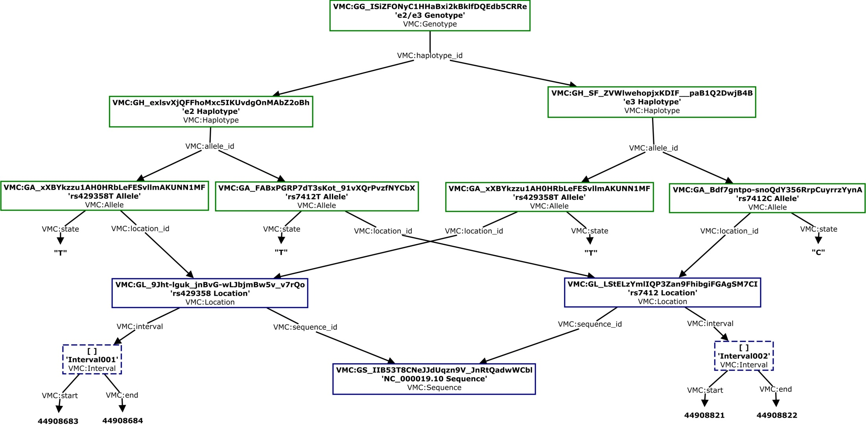
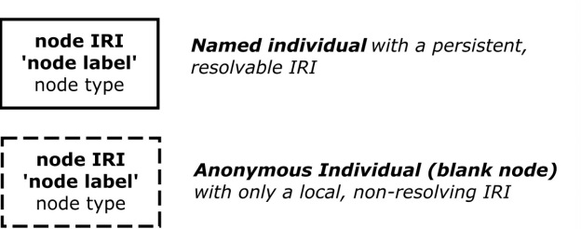
Figure 2: VMC Model of ApoE Exemplar Genotype
Figure 2: A graph-based representation of the VMC JSON model of the ApoE example genotype (i.e. what might look like if had JSON-LD context mapping). Compare with the GENO-based graph representation in Figure 3. As noted in the Key, the content of each node specifies its IRI, a human readable label, and the 'type' of entity the node represents according to the VMC model.
KEY
green nodes = genotype composition
blue nodes = allele position information

Slide 4
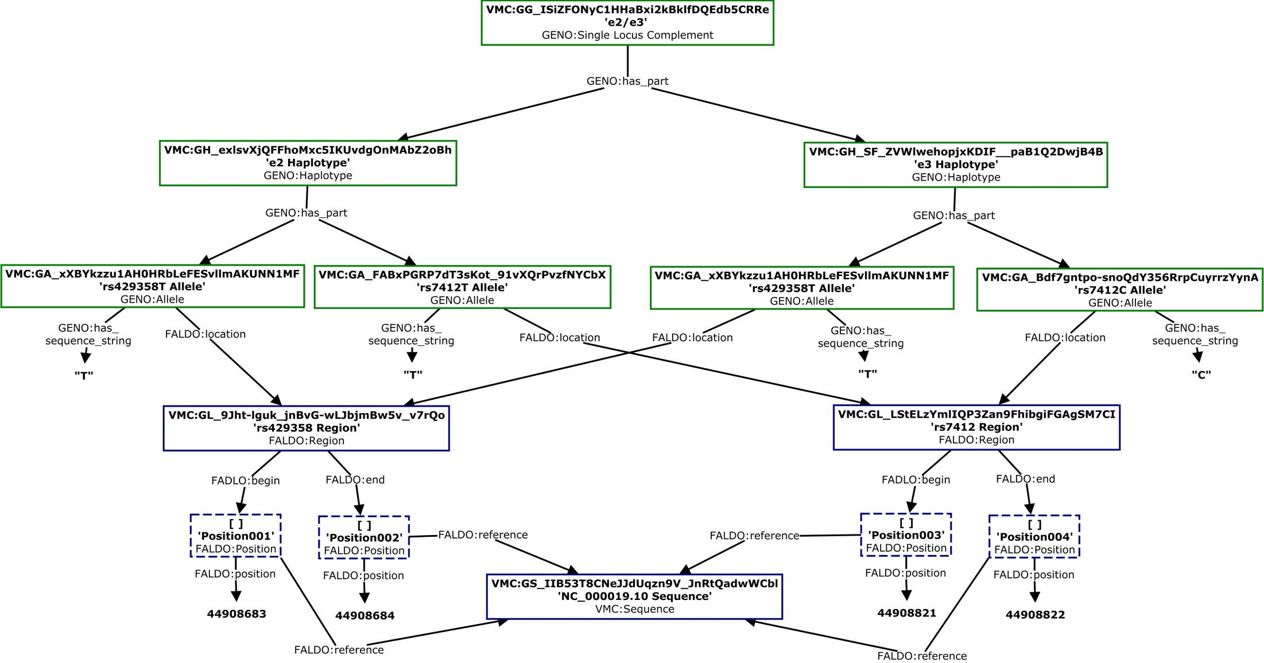
Figure 3: GENO Model of ApoE Exemplar Genotype
Figure 3: A graph-based representation of the GENO model of the ApoE example genotype. Compare to the VMC model in Figure 2. As noted in the Key, the content of each node specifies its IRI, a human readable label, and the 'type' of entity the node represents according to the GENO model.
KEY
green nodes = genotype composition
blue nodes = allele position information

Slide 5
Comparison / Summary
VMC and GENO modeling of how genotypes are composed from haplotypes and alleles is isomorphic (green nodes in each figure). Here, GENO uses has_part relations to link genotypes to more fundamental units of variation (haplotypes and alleles).
An LD-context file mapping vmc:haplotype_id and vmc:allele_id to geno:has_part, and vmc:state to geno:has_sequence_string would effectively transform this portion of the data from VMC JSON data into GENP-compliant RDF.
By contrast, representation of positional information is not entirely isomorphic (blue nodes). GENO adopts the FALDO model which is similar to VMC in how it creates an entity representing the mapping to a reference sequence ('Location' in VMC, 'Region' in FALDO), and uses this to define position against an explicitly stated reference sequence. But FALDO model is slightly more verbose in that it creates separate FALDO:Position nodes for begin and end positions (to accommodate use cases where different reference sequences are used to define start and stop coordinates). The reference sequence is link from these Position nodes, rather than their parent Region node.

